Slide 1
Springboard Capstone Presentation
By Joshua Karpen
Predicting Price and Utilization of AirBnB Listings

Slide 2

The Problem
AirBnB pricing recommendations not transparent
Customers want to find the best deals
Hosts want to know the best price to charge to attract customers
Insert-Data-Science-is-the-Solution-To-Everything-Quote-Here

Slide 3
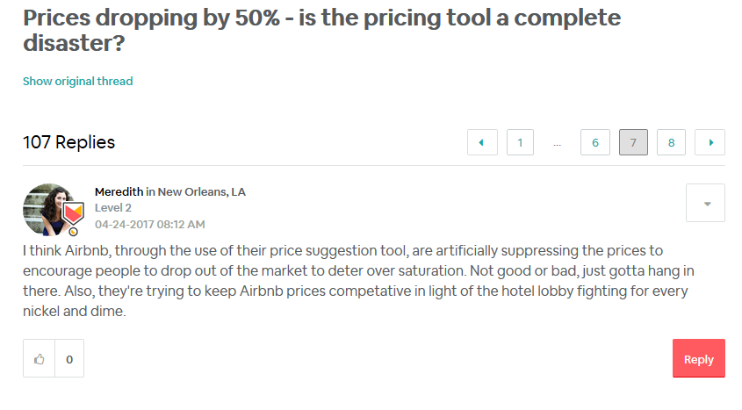
The Problem

Slide 4
How can Data Science Help?
Goal: To help AirBnB hosts find the best price to set their listing at to meet a desired utilization rate
What price can I set my listing to ensure it is filled at least 50% of the time?
This is a prediction problem – we can predict the price of a listing based on various factors
Then, we can predict the utilization of the listing based on how close the actual price is to the predicted price
Theory to test: An over-priced listing will be booked less often. An under-priced listing will be booked more often.

Slide 5


Datasets Used
AirBnB data scraped regularly by Inside AirBnB, for most major cities
Listing details, like # bedrooms, bathrooms, daily price, property type, bed type, and ~ 40 more variables including lat/long (generalized to within a few hundred feet)
Calendar and Review data – not used – focused on helping new hosts first, likely do not have any reviews yet
Yelp releases a dataset annually with facts about businesses in a small number of cities.
Type of business, ratings, lat/long
Used to enrich AirBnB data – how many businesses and how popular are they, within a certain radius of each AirBnB listing?
Notes:
http://insideairbnb.com/
https://www.yelp.com/dataset

Slide 6
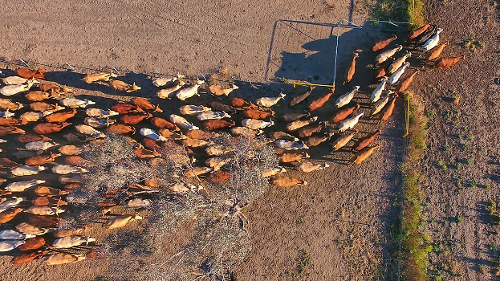
Fixing Data Quality Issues (Data Wrangling – YeeHAW!)

Slide 7
Data Quality Issues
Lots of null values, outliers
Some columns only one value
Missing values – some missing entirely, some missing partially
If > 50% missing, dropped entirely
Otherwise imputed
Need to combine ~30 Property Types
Anything below threshold grouped into “Other”
Neighborhood names did not match between AirBnB and Yelp
Manual consolidation

Slide 8
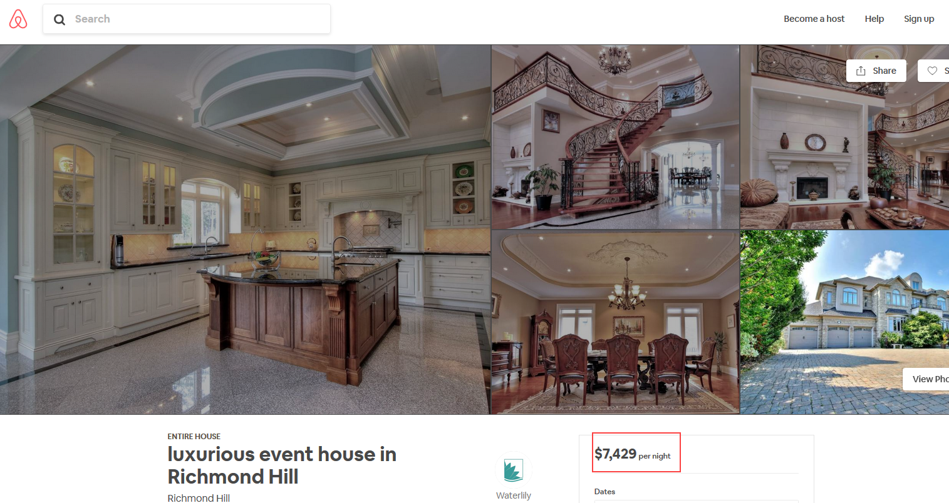
Outliers - Price
A handful of listings had an extremely high price – $3K-$12K (per night!)
These are not representative of most listings, so I decided to remove them

Slide 9
Data Quality Issues - Merging AirBnB and Yelp data
Joined on Neighborhood
AirBnB listings duplicated for each Yelp restaurants/bars in same neighborhood
First had to clean neighborhood names so they matched
Calculated distance between each listing and each Yelp business
Summarized to determine # restaurants/bars w/in .1 mile and .5 mile of each AirBnB listing

Slide 10

Exploratory Data Analysis

Slide 11
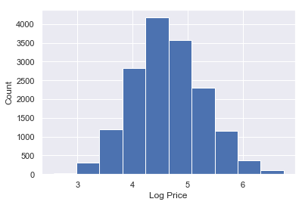
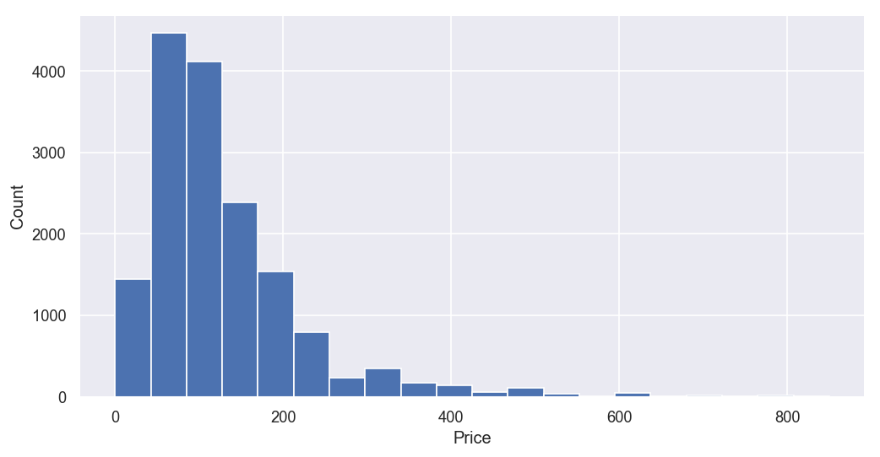
Important Findings
Price distribution skewed right – converting to log comes closer to a normal distribution

Slide 12
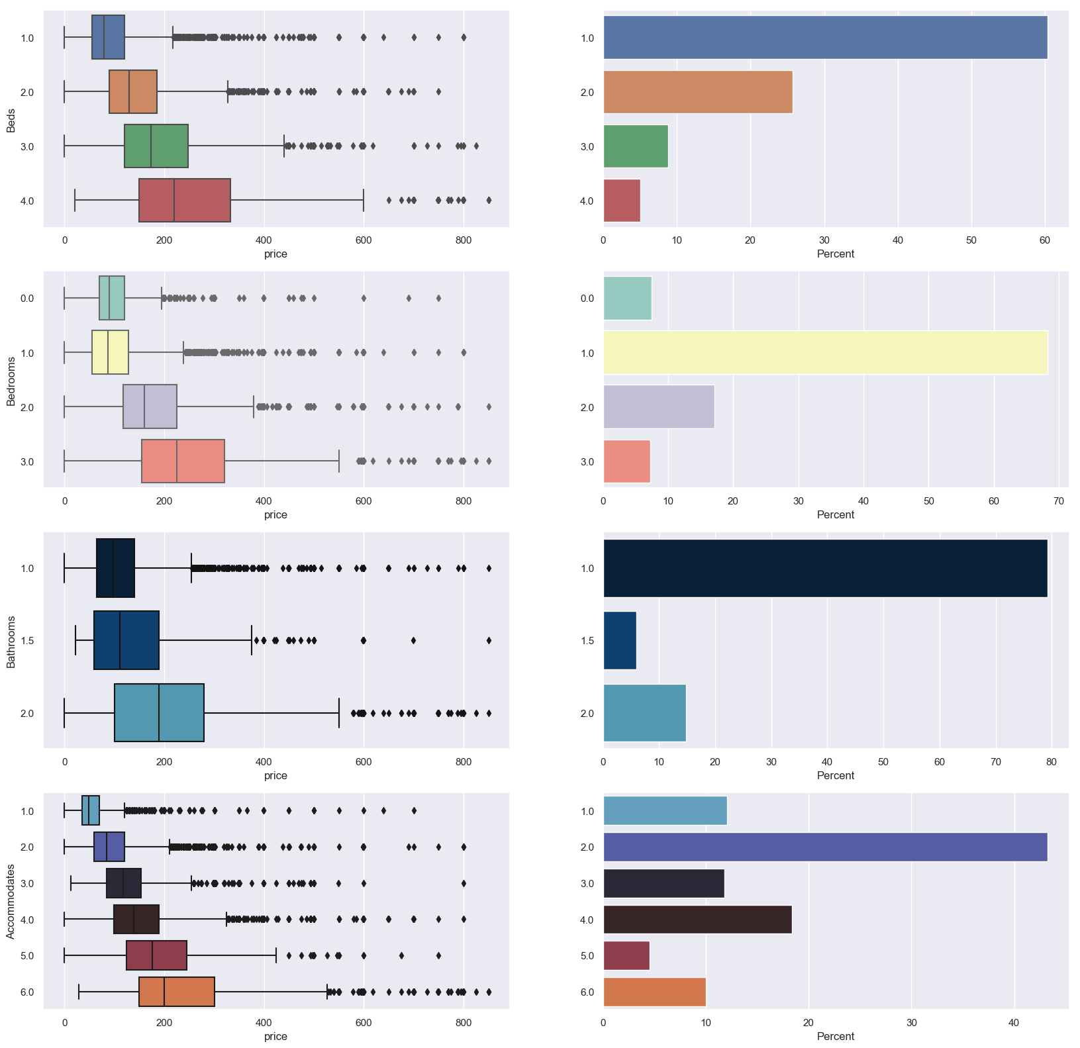
Important Findings
Higher # of Beds, Bedrooms, Bathrooms, and people accommodated showed strongest relationship to price

Slide 13
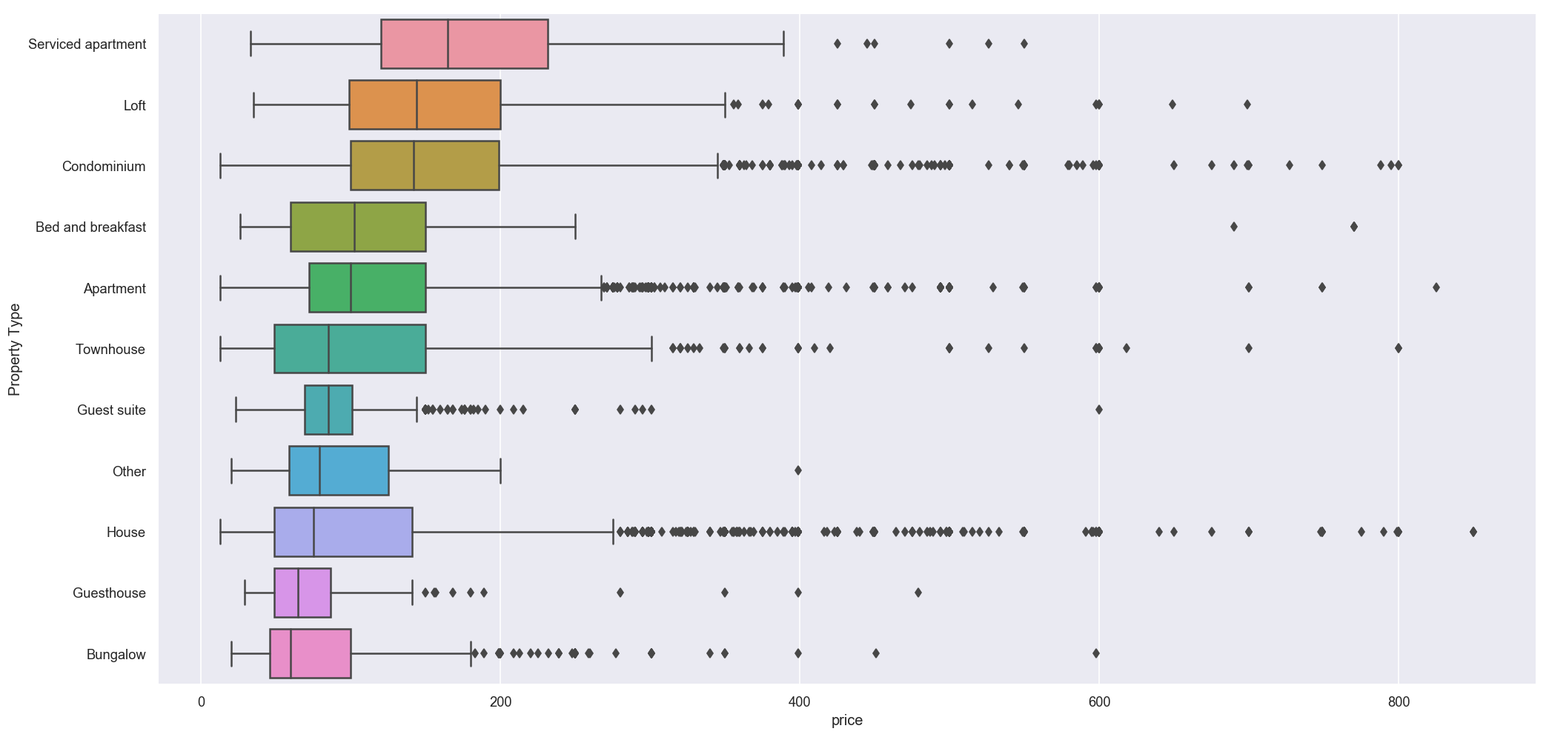
Important Findings
Serviced Apartments, Lofts, and Condominiums, have highest median price
Guest Suites, Bungalows, and Guesthouses have lowest median price

Slide 14



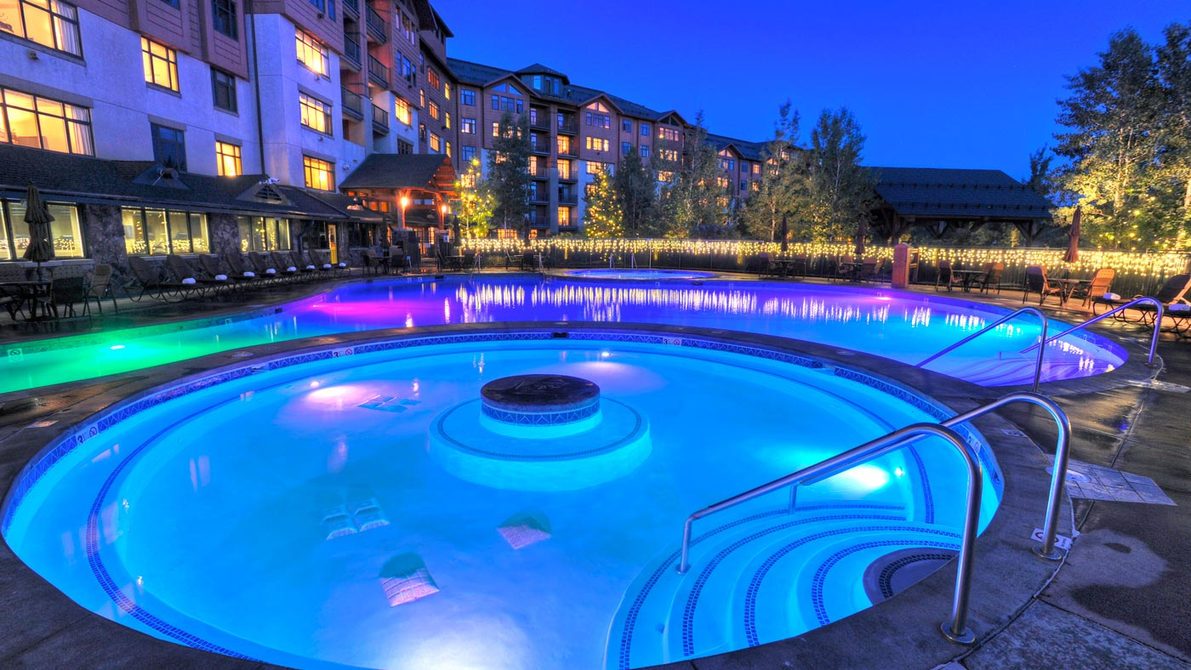

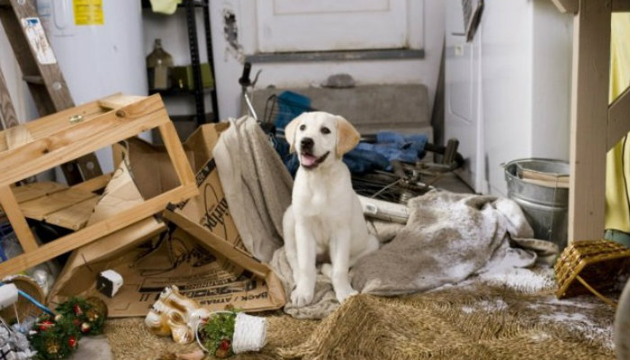

Important Findings
Having any bar or restaurant within .1 miles of a listing is good for a $35 higher average price ($147 vs. $112)
Having any bar or restaurant within .5 miles of a listing is good for a $30 higher average price ($131 vs. 101)
TV, Pool, and Gym are the most correlated with higher-value listings
Allowing pets, smoking, and off-premises or street parking are most correlated with lower-value listings

Slide 15
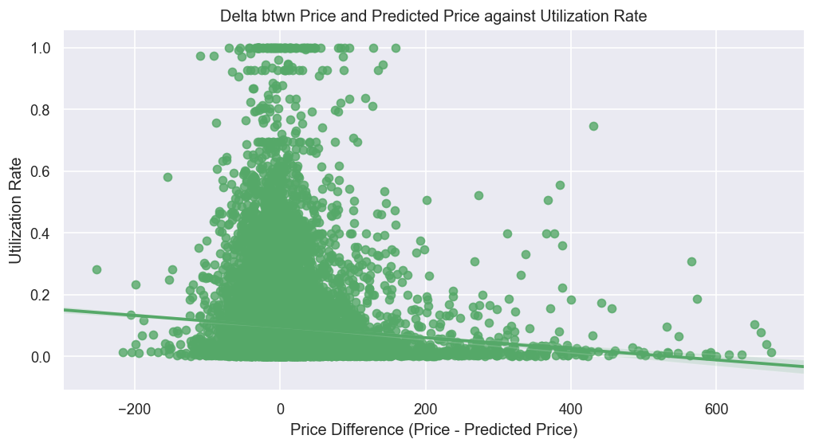
Important Findings
Utilization Rate highest for listings with the most accurate price predictions (not over- or under-priced)

Slide 16
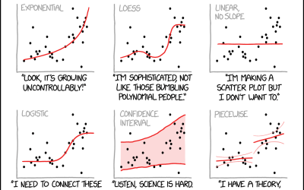
Modeling
Notes:
Cartoon from XKCD

Slide 17
Model Chosen & Why
Predicting Price
Tested Linear Regression, Ridge Regression, Lasso, and Random Forest
Random Forest performed best, R^2 = 0.64 on test set
Predicting Utilization
Testing Linear Regression, Ridge Regression, and Random Forest
Ridge Regression performed best, but overall performance not great
R^2 never higher than 0.1 on test set

Slide 18
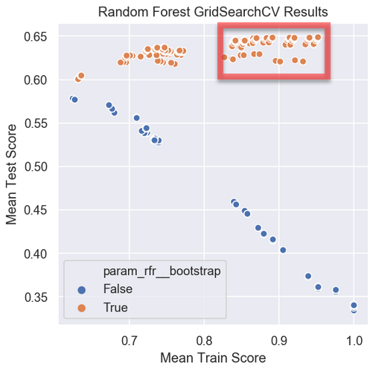
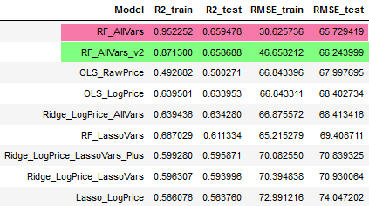
Results
Best Random Forest Estimator found during gridsearch showed signs of overfitting (R^2 much higher in train than test).
Decreasing tree depth, increasing min samples to split lead to a better model with less overfitting

Slide 19
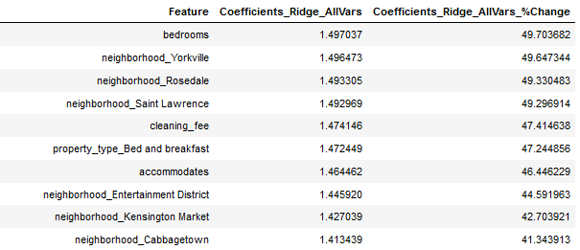
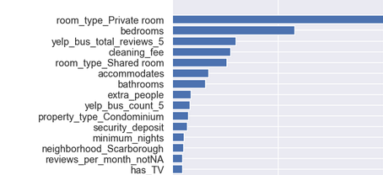
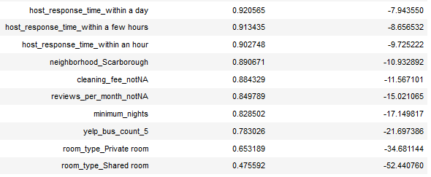
Results
Ridge Regression Coefficients Top/Bottom 10
Random Forest Feature Importances

Slide 20
Recommendations
Bigger listings – more beds, bedrooms, bathrooms – can charge more
If possible, try to let the guest have the entire place to themselves – private rooms and shared rooms perform much worse than a dedicated location all to them
Higher priced listings wait to respond to hosts - lower priced listings reply in under a day
Certain neighborhoods (Entertainment District, Yorkville, Rosedale) perform better than others (Scarborough)

Slide 21
Suggestions for Improvement/Next Steps
Use PCA and/or other feature creation methods to try to improve both models
Other model types might do better – a deep learning neural network for example
Use the calendar data from Inside AirBnB to incorporate a time component to the price and utilization models
Model Deployment: create an interactive dashboard where end users can enter information about their listing (for hosts) or a prospective listing (for guests) and see an estimated nightly price

